Slide 1
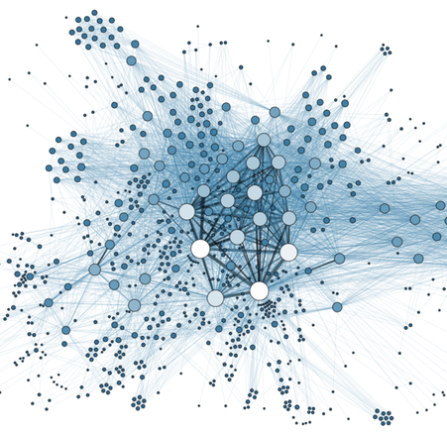
Graphs
Prof. Darrell Long
CSE 13S

Slide 2
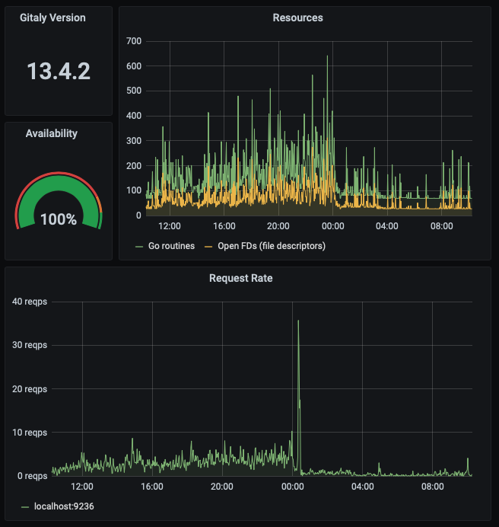
Is this a graph?
Yes, this is commonly called a graph, but it is not what we are talking about here…
We will call these depictions of numerical quantities plots.

Slide 3
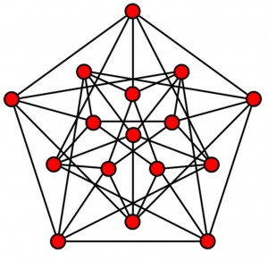
Is this a graph?
This is an example of what we will call a graph.
There is an entire branch of mathematics dedicated to graph theory.
Graphs of this type are used in mathematics, computer science, physics, and even sociology.

Slide 4
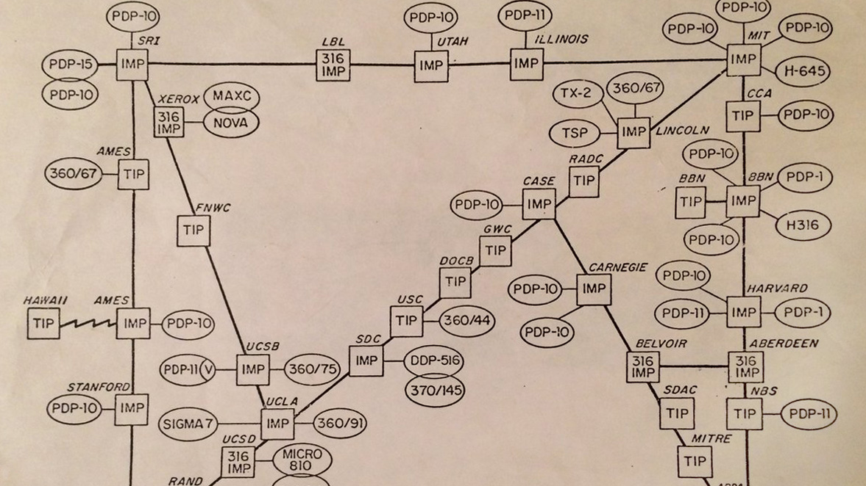
Network Routing
The Internet (originally called ARPAnet) is a graph.
The nodes are computers (one reason that we call computers nodes).
The edges are the connections.
Routers are nodes with many edges.

Slide 5
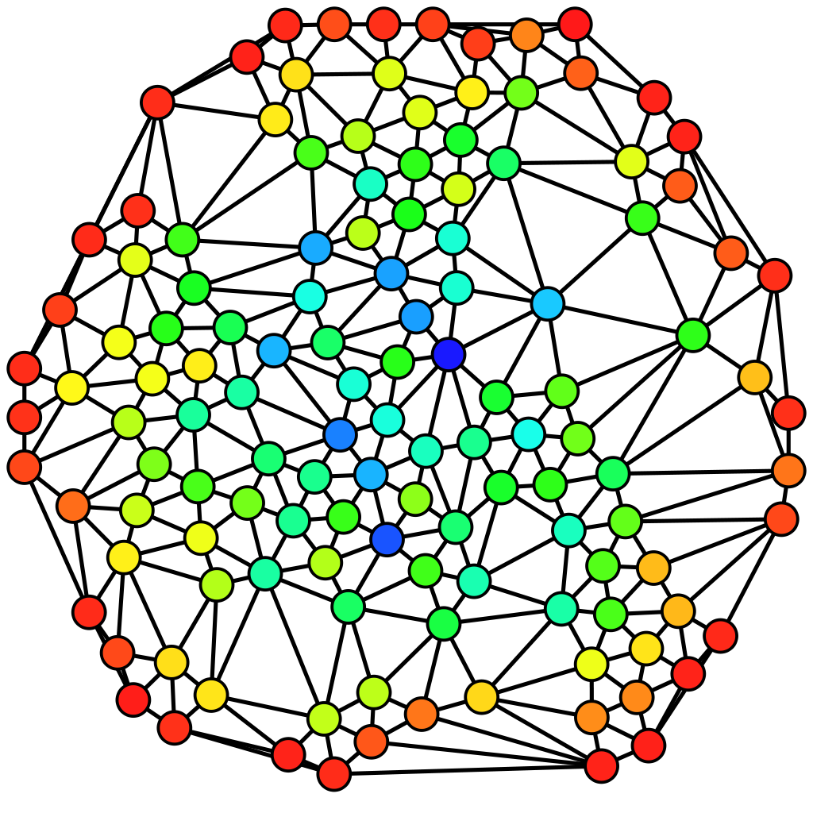
Social Networks

Slide 6
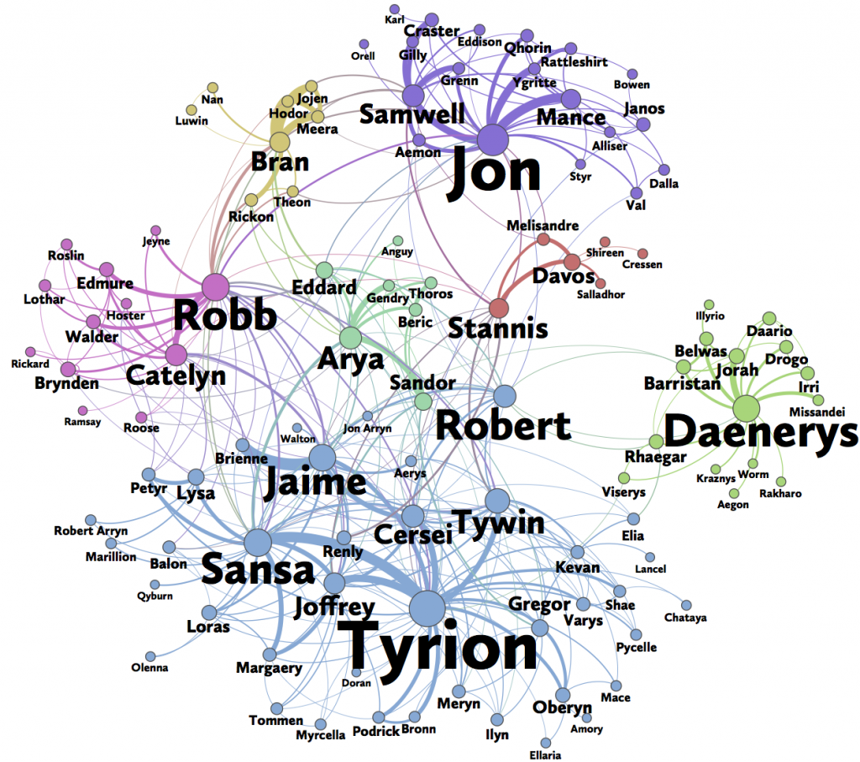
Network of Thrones

Slide 7
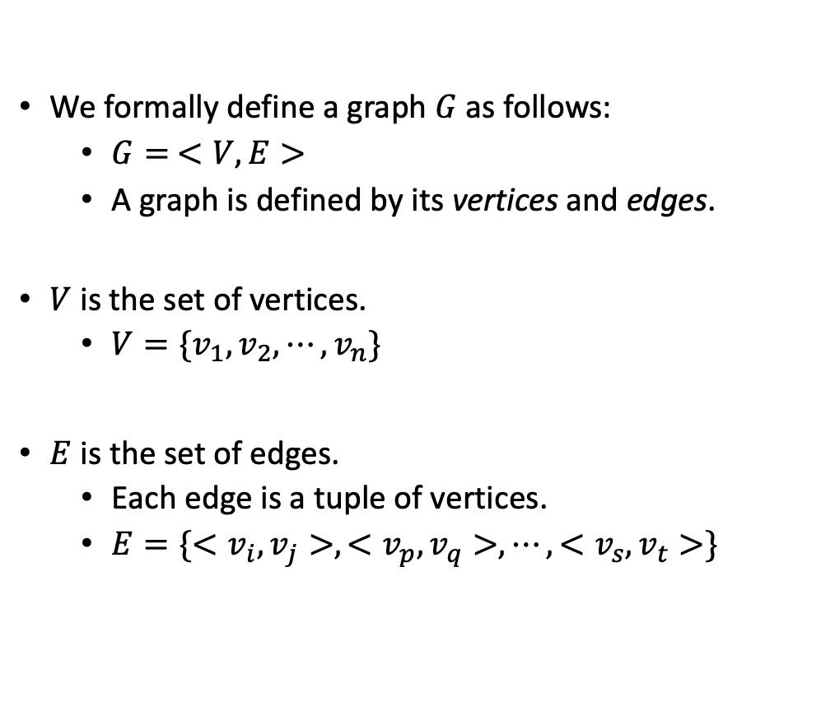
A Formal Definition
We formally define a graph $G$ as follows:
$G= <V, E>$
A graph is defined by its vertices and edges.
$V$ is the set of vertices.
$V=\{v_{1},v_{2},⋯,v_{n}\}$
$E$ is the set of edges.
Each edge is a tuple of vertices.
$E=\{{<v}_{i},v_{j}>,{<v}_{p},v_{q}>,⋯,{<v}_{s},v_{t}>\}$

Slide 8
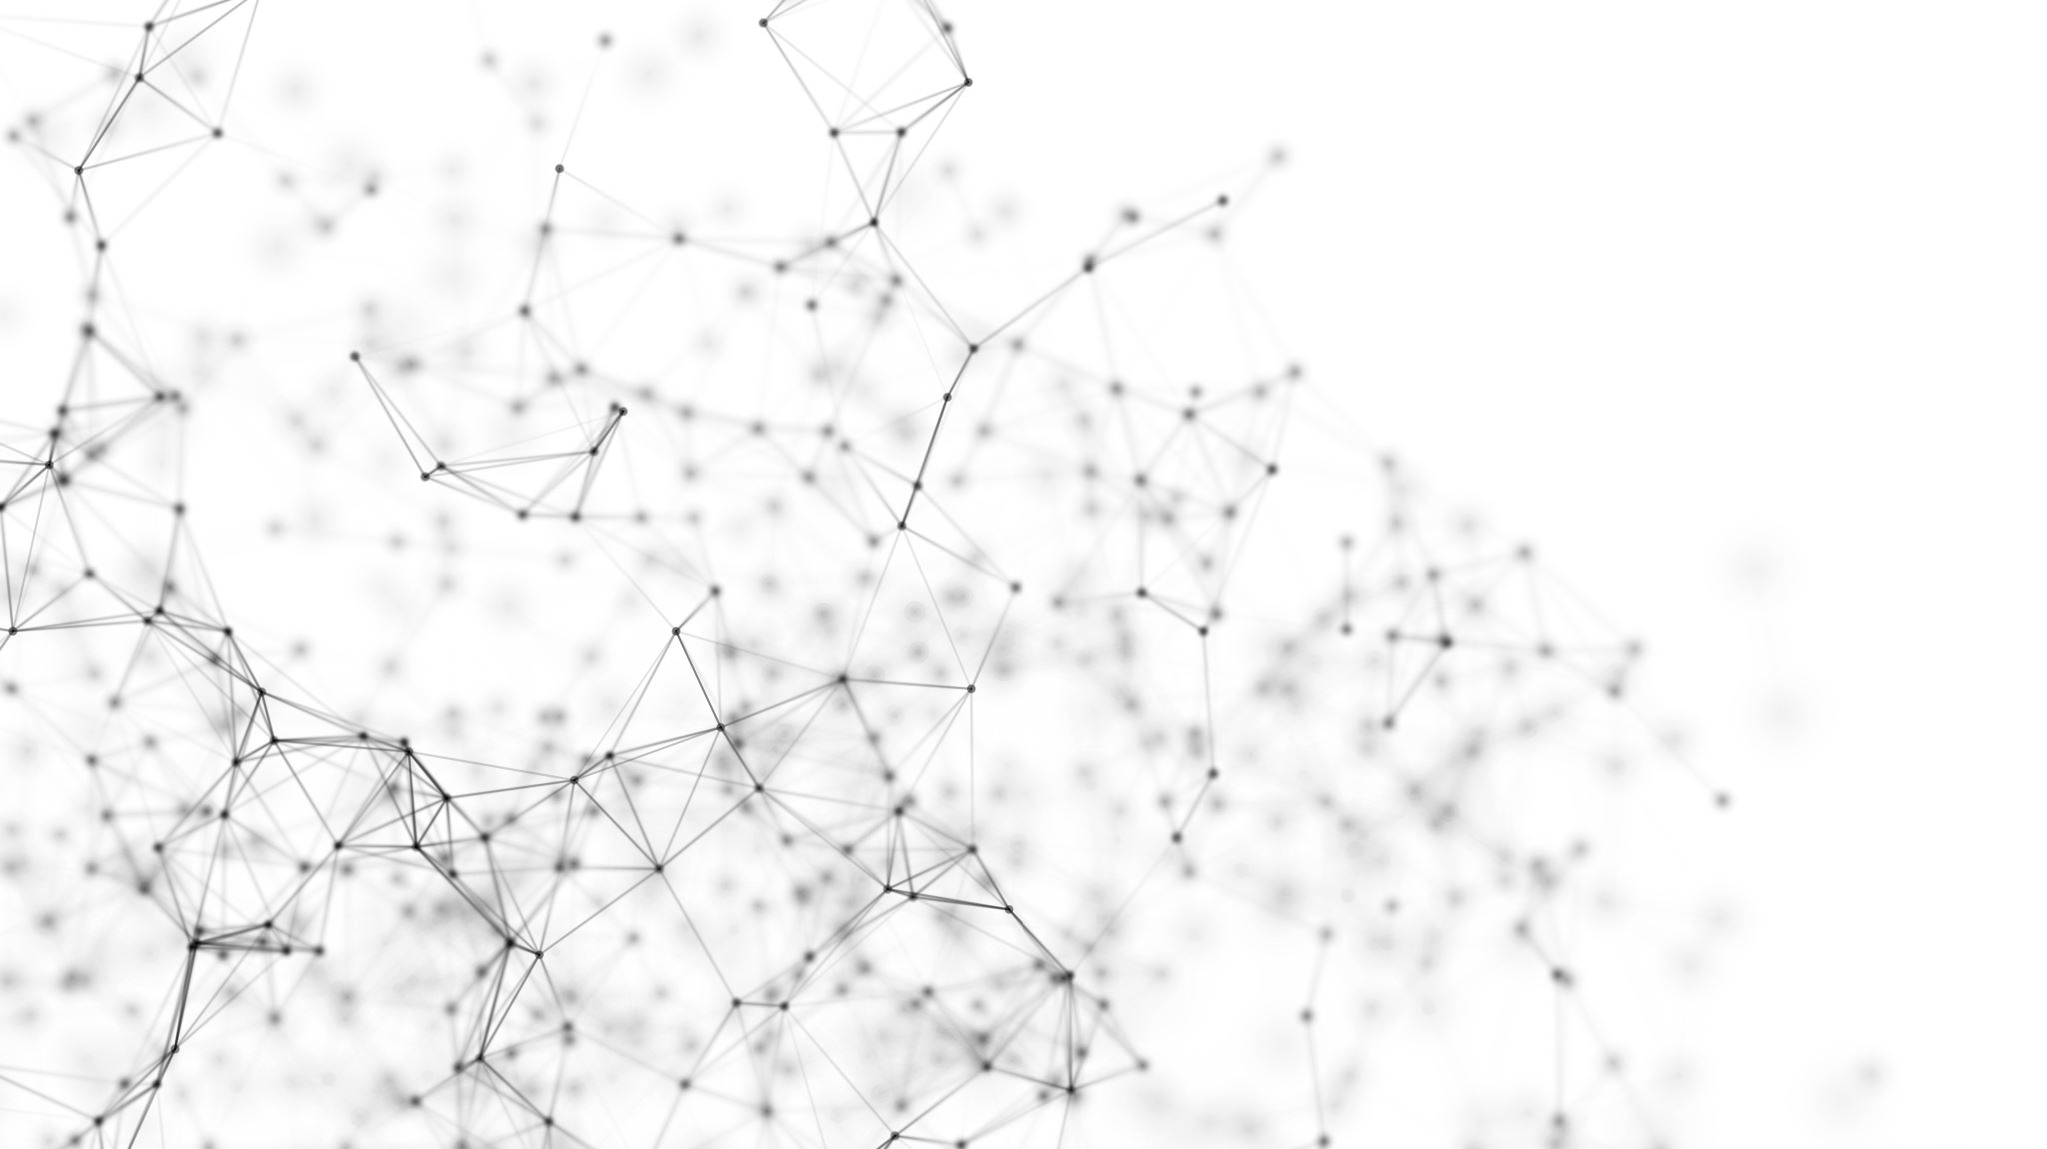

Directed and Undirected Graphs
Edges may have a direction, $n_{1}→n_{2}$, and we call that a directed graph.
Edges may have no direction (or both directions), $n_{1}↔n_{2}$, and we call that an undirected graph.
The edges may have weights, which represent capacity, strength, or cost.

Slide 9
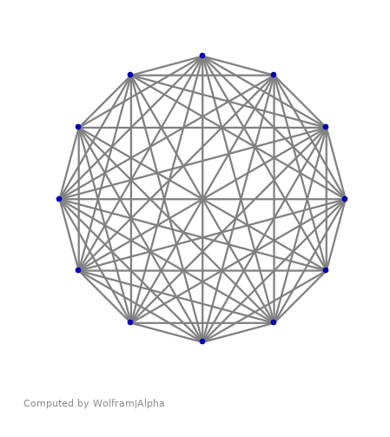

Representing a graph
Adjacency Matrix
$n × n$ matrix
Binary: edges present or absent
Weighted: $n≠0$
Adjacency List
Column array for nodes
Linked list of edges from each node
May contain weights

Slide 10
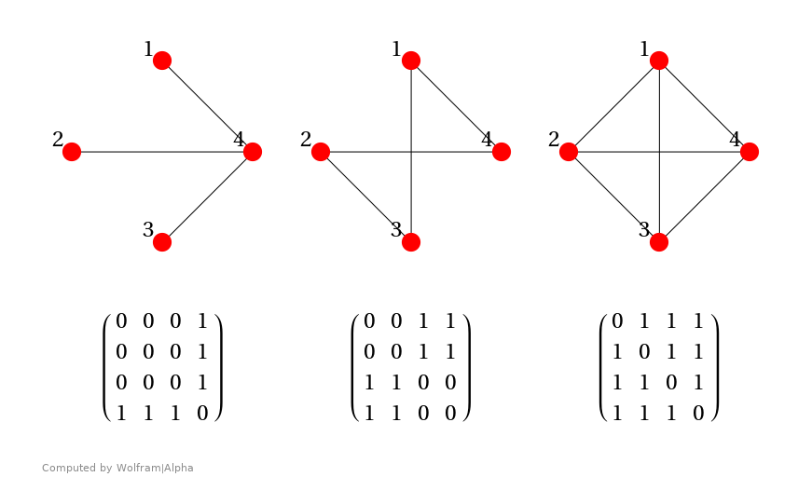

Adjacency Matrix
A non-zero entry in $M_{i,j}$ means there is an edge $n_{i}→n_{j}$.
A matrix that is symmetric around the diagonal represents an undirected graph.
The entry can specify not only the existence of an edge, but also its weight.
Requires $O\left(n^{2}\right)$ space.
Sparse matrix techniques can improve it.

Slide 11
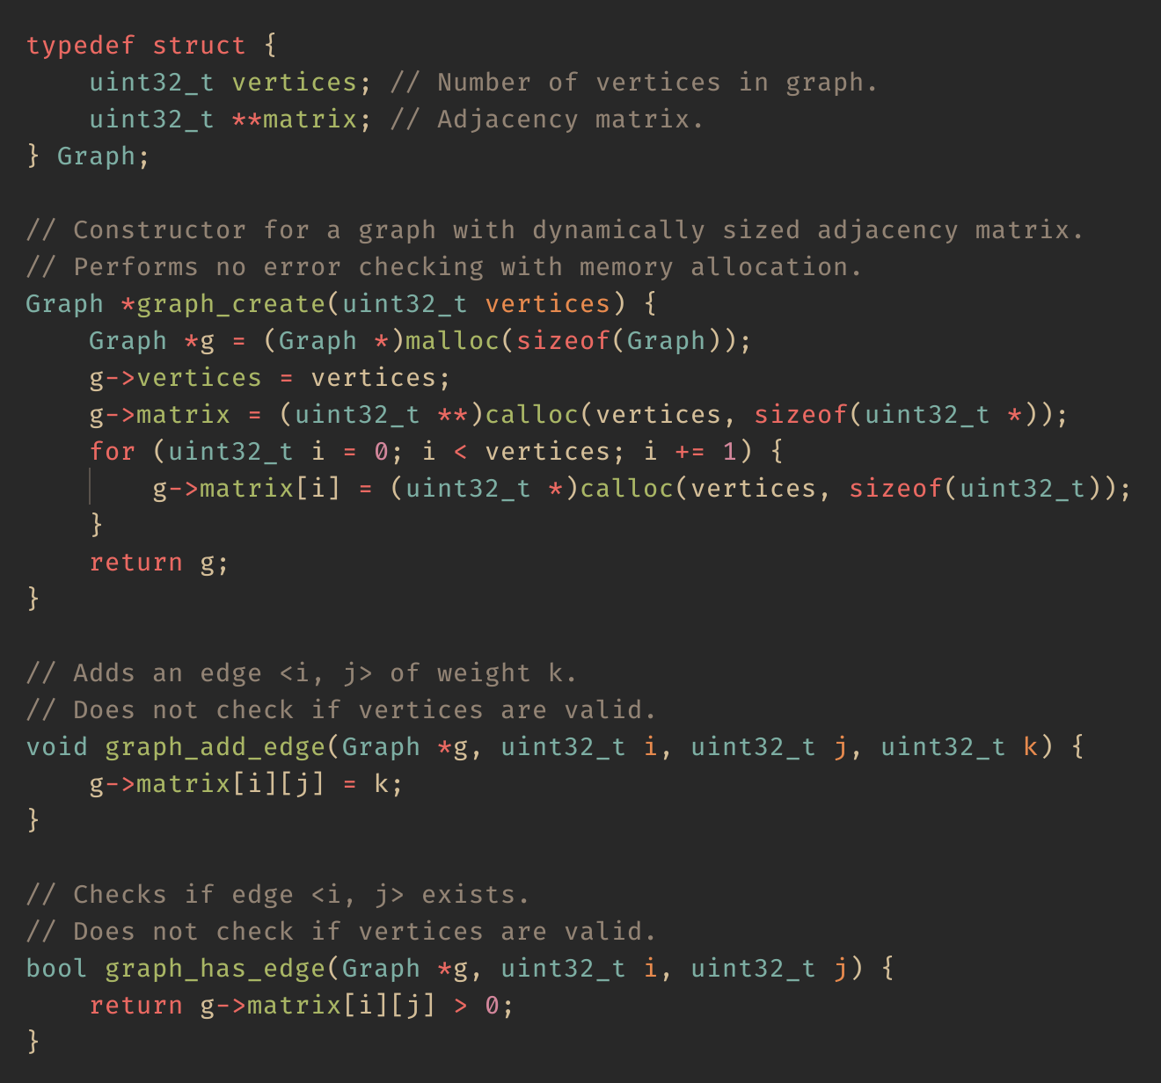
A graph in C
Uses dynamically sized adjacency matrix.
Adding an edge is O(1).
Checking for the existence of an edge is also O(1).

Slide 12
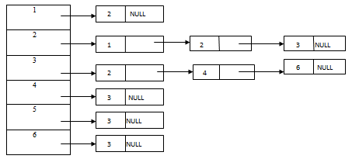

Adjacency List
Each node is represented as an entry in a column vector.
Each entry is the head of a linked list.
The list elements contain:
The destination node, and
The weight of the edge.
Why would you prefer this over an adjacency matrix?
An adjacency matrix is $O(n^{2})$ space,
An adjacency list will be more space efficient for sparse graphs.

Slide 13
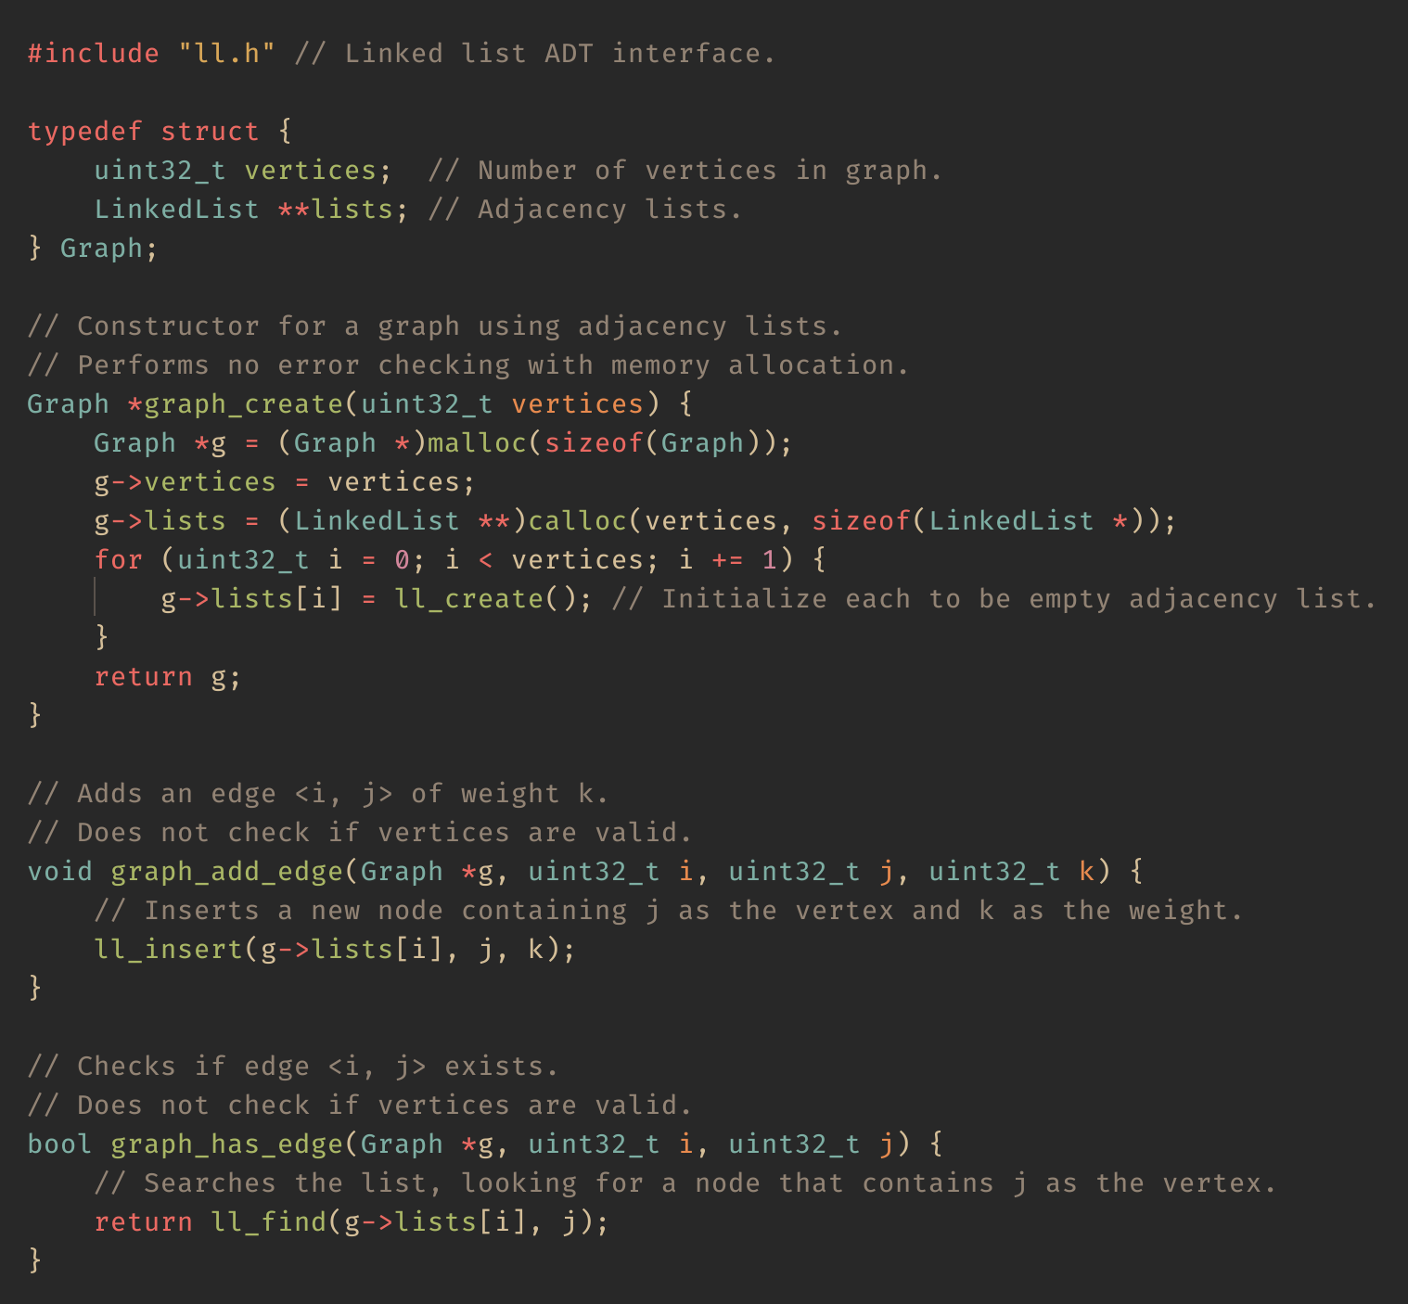
Another graph in C
Uses adjacency lists.
Implemented using linked lists.
Adding an edge is O(1).
Checking for the existence of an edge is O(n).
Must traverse entire list!

Slide 14
Basic Graph Algorithms
We often want to find something in a graph.
Two ways of searching a graph:
Breadth-first search
Uses a queue.
Explore the set of vertices immediately reachable.
Then repeat the process for each vertex in the set.
Also known as “level-order” traversal.
Depth-first search
Uses recursion or a stack.
Search as far as possible before backing up.
We will showcase iterative DFS using a stack.

Slide 15
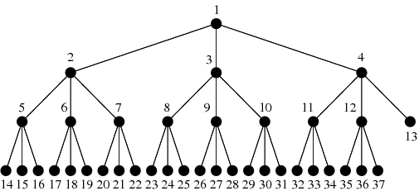
Trees
Trees are form of acyclic graph.
Acyclic means that if you follow the edges, there are no loops (cycles).
You will often hear the term DAG, which stands for:
Directed
Acyclic
Graph

Slide 16
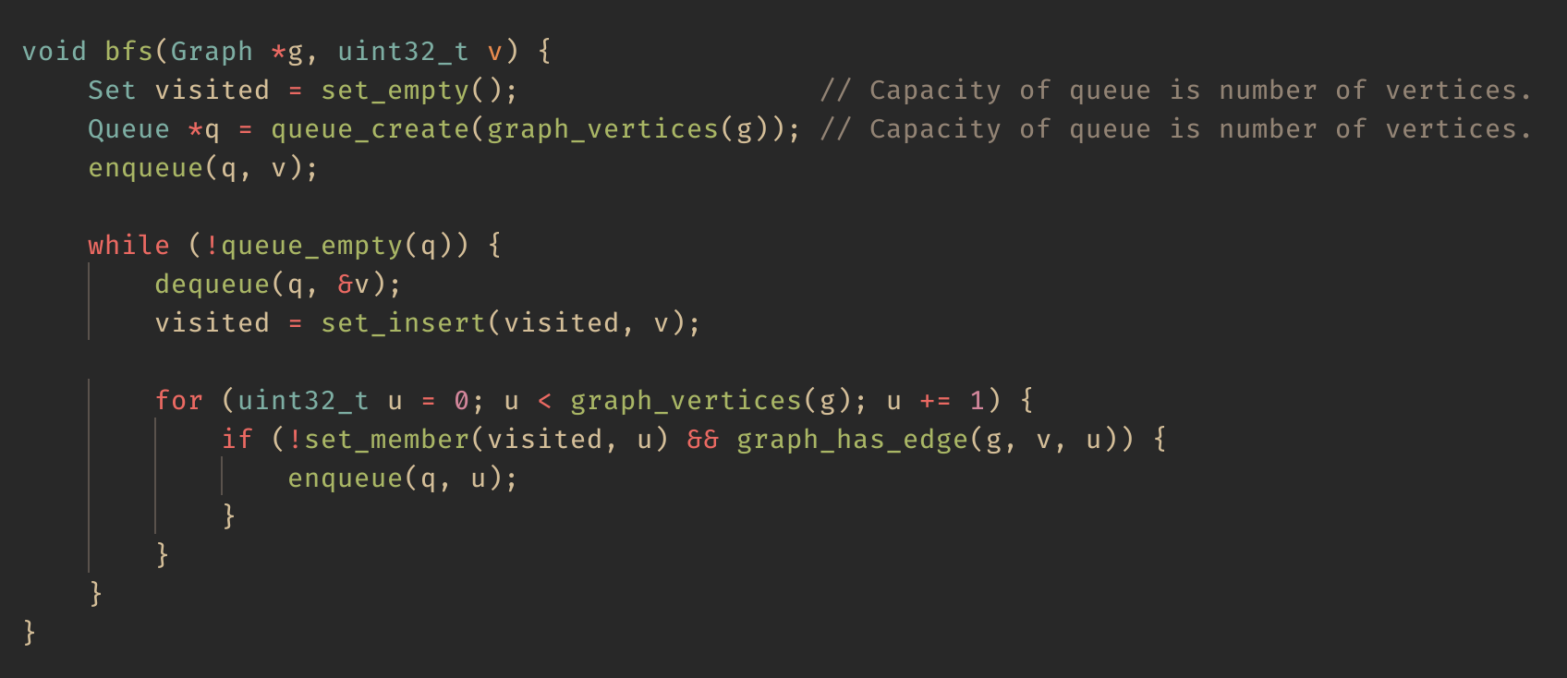
Breadth-First-Search (BFS)
0
1
2
3
4
5
6
7
Queue: 0

Slide 17
Breadth-First-Search (BFS)
0
1
2
3
4
5
6
7
Queue: 1, 2, 3

Slide 18
Breadth-First-Search (BFS)
0
1
2
3
4
5
6
7
Queue: 2, 3, 4, 5

Slide 19
Breadth-First-Search (BFS)
0
1
2
3
4
5
6
7
Queue: 3, 4, 5, 6

Slide 20
Breadth-First-Search (BFS)
0
1
2
3
4
5
6
7
Queue: 4, 5, 6, 7

Slide 21
Breadth-First-Search (BFS)
0
1
2
3
4
5
6
7
Queue: 5, 6, 7

Slide 22
Breadth-First-Search (BFS)
0
1
2
3
4
5
6
7
Queue: 6, 7

Slide 23
Breadth-First-Search (BFS)
0
1
2
3
4
5
6
7
Queue: 7

Slide 24
Breadth-First-Search (BFS)
0
1
2
3
4
5
6
7
Queue: 7

Slide 25
Breadth-First-Search (BFS)
0
1
2
3
4
5
6
7
Queue:

Slide 26
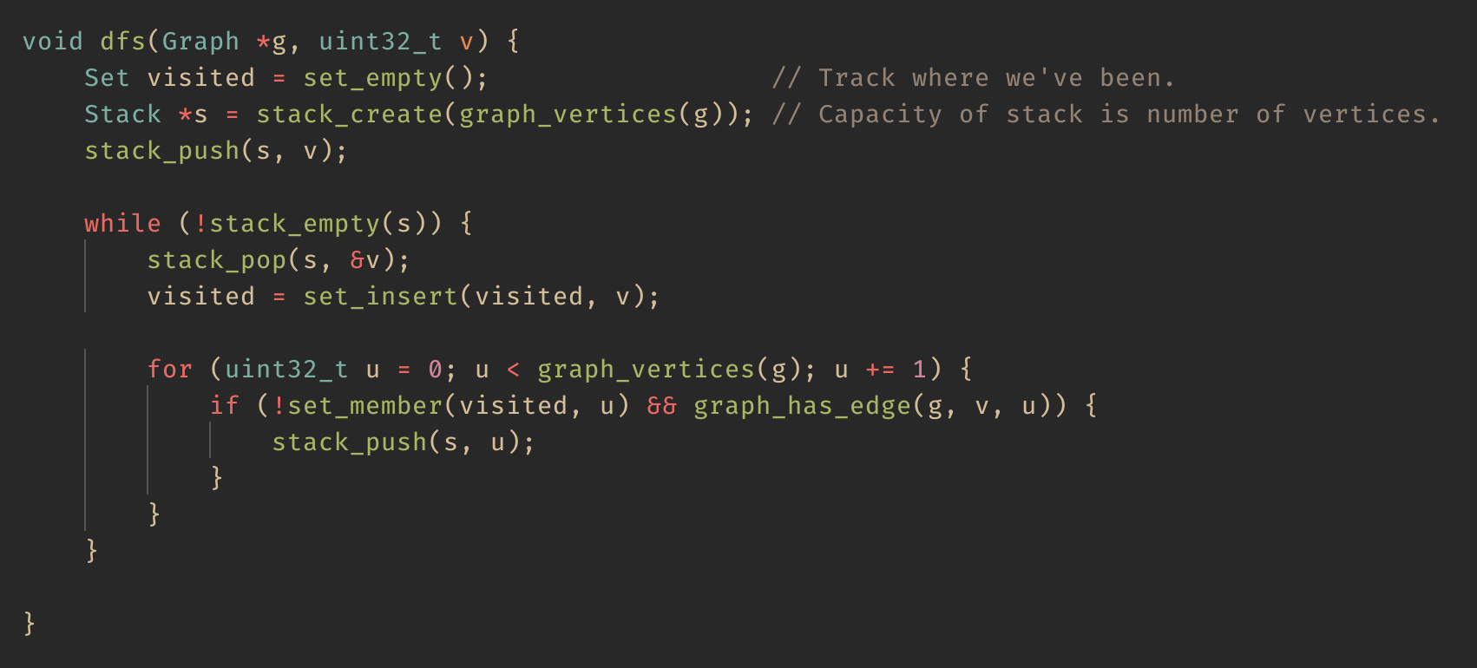
Depth-First-Search (DFS)
0
1
2
3
4
5
6
7
Stack: 0
Top of stack will be the rightmost element.

Slide 27
Depth-First-Search (DFS)
0
1
2
3
4
5
6
7
Stack: 1, 2, 3
Top of stack will be the rightmost element.

Slide 28
Depth-First-Search (DFS)
0
1
2
3
4
5
6
7
Stack: 1, 2, 7
Top of stack will be the rightmost element.

Slide 29
Depth-First-Search (DFS)
0
1
2
3
4
5
6
7
Stack: 1, 2
Top of stack will be the rightmost element.

Slide 30
Depth-First-Search (DFS)
0
1
2
3
4
5
6
7
Stack: 1, 6
Top of stack will be the rightmost element.

Slide 31
Depth-First-Search (DFS)
0
1
2
3
4
5
6
7
Stack: 1
Top of stack will be the rightmost element.

Slide 32
Depth-First-Search (DFS)
0
1
2
3
4
5
6
7
Stack: 4, 5
Top of stack will be the rightmost element.

Slide 33
Depth-First-Search (DFS)
0
1
2
3
4
5
6
7
Stack: 4
Top of stack will be the rightmost element.

Slide 34
Depth-First-Search (DFS)
0
1
2
3
4
5
6
7
Stack: 4
Top of stack will be the rightmost element.

Slide 35
Depth-First-Search (DFS)
0
1
2
3
4
5
6
7
Stack:
Top of stack will be the rightmost element.

Slide 36
Topological Sort
Linearly orders vertices in a DAG such that, for any directed edge <u,v>, u appears before v.
Typically used to indicate ordering of dependencies.
Such as in a Makefile!
Implemented using DFS:
Whenever a vertex is finished, it is prepended to a list.
Finished vertex: no more exploration possible from that vertex.
Topological orderings are not unique.
Could be more than one valid topological ordering.
sorting
sorting.o
shell.o
heap.o
sorting.c
shell.c
heap.c

Slide 37
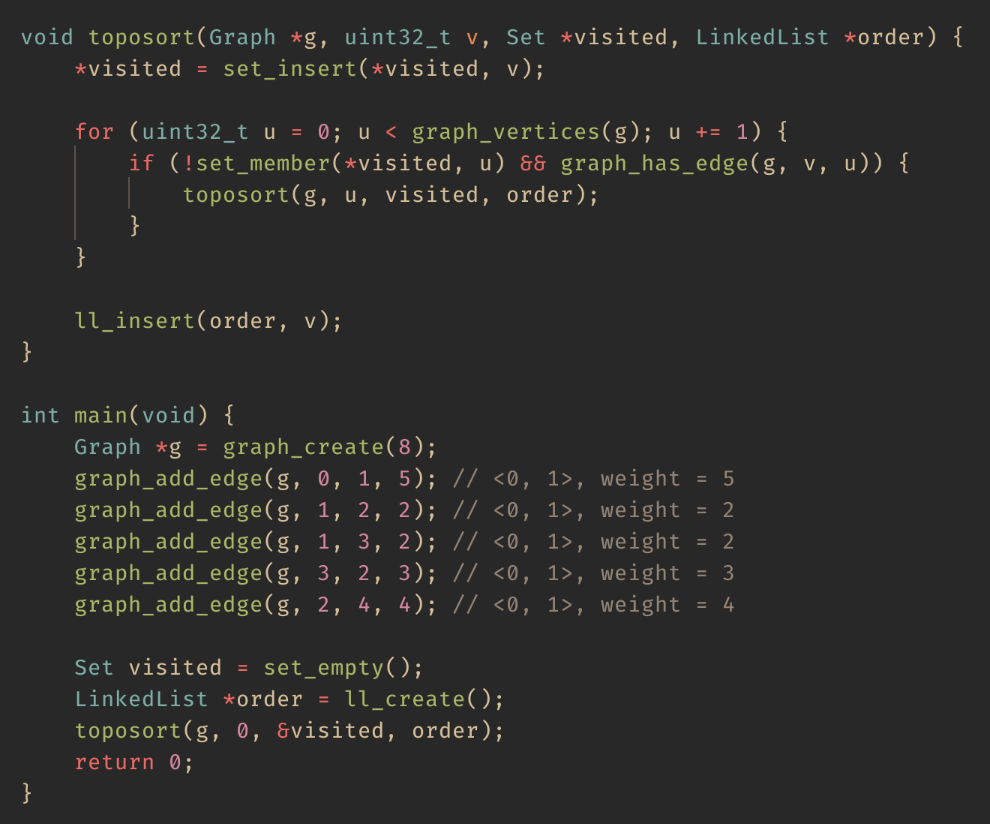
Modified DFS to Topologically Sort (Recursive)
0
1
2
3
4
Order:
0
1
3
2
4

Slide 38
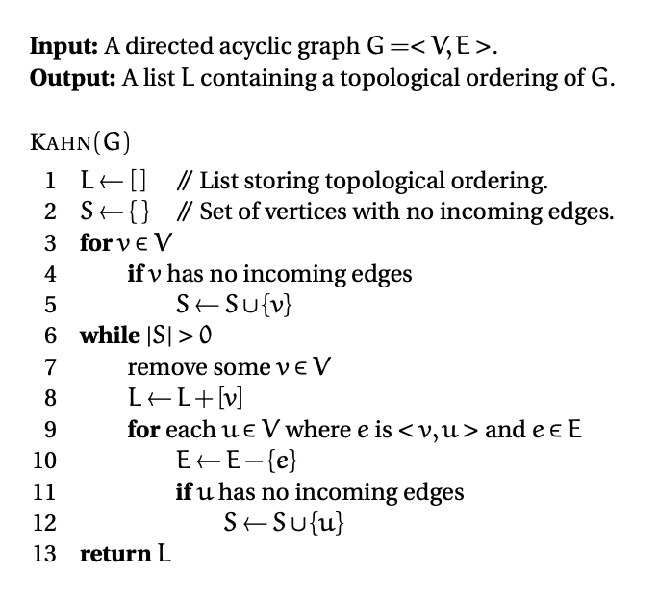
Kahn’s Algorithm

Slide 39
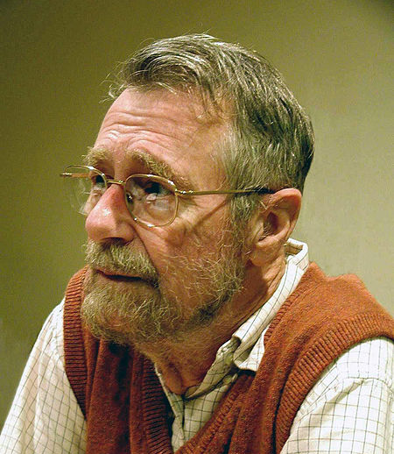
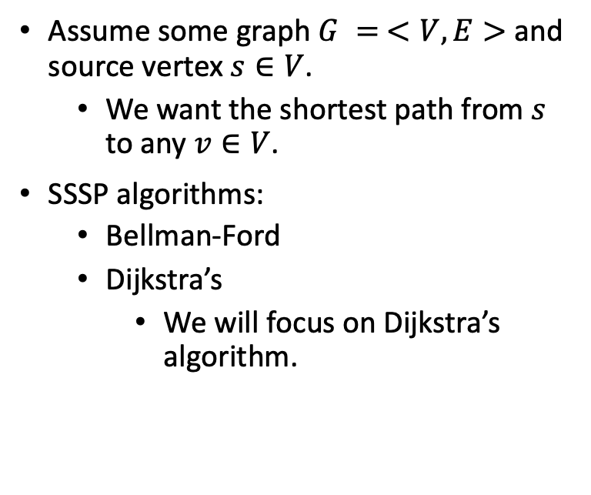
Single-Source Shortest Paths (SSSP)
Assume some graph $G = <V,E>$and source vertex $s∈V$.
We want the shortest path from $s$ to any $v∈V$.
SSSP algorithms:
Bellman-Ford
Dijkstra’s
We will focus on Dijkstra’s algorithm.

Slide 40
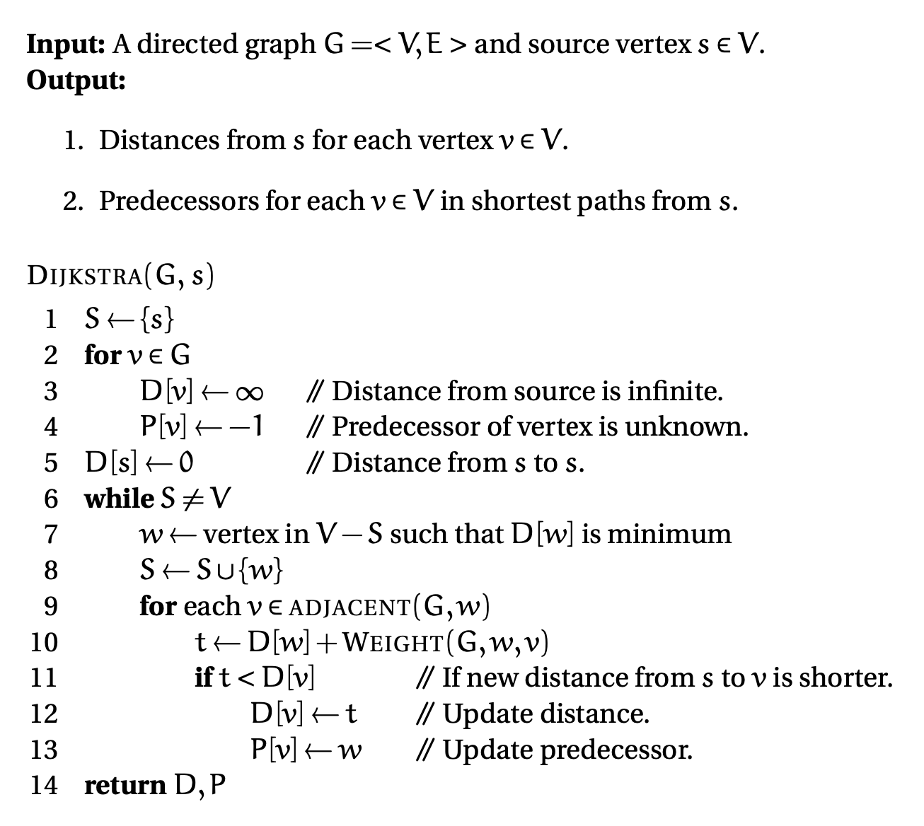
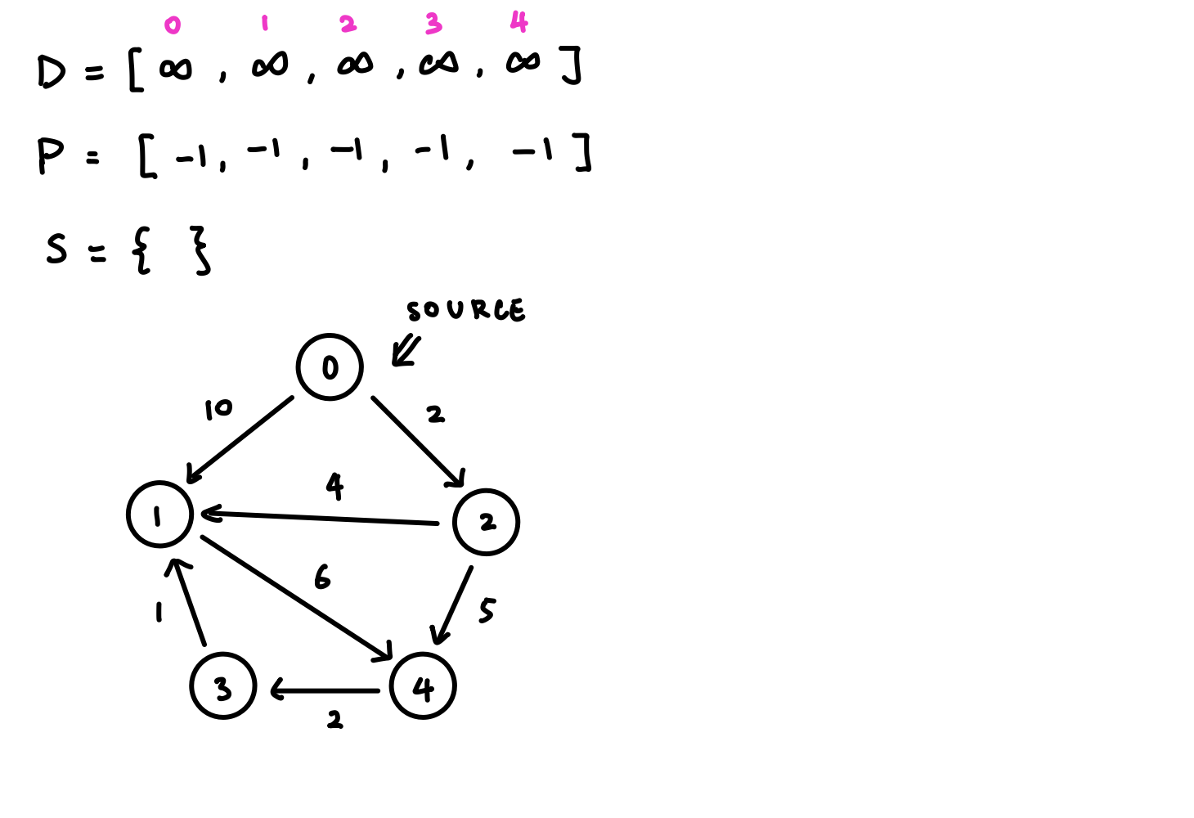
Dijkstra’s Algorithm

Slide 41
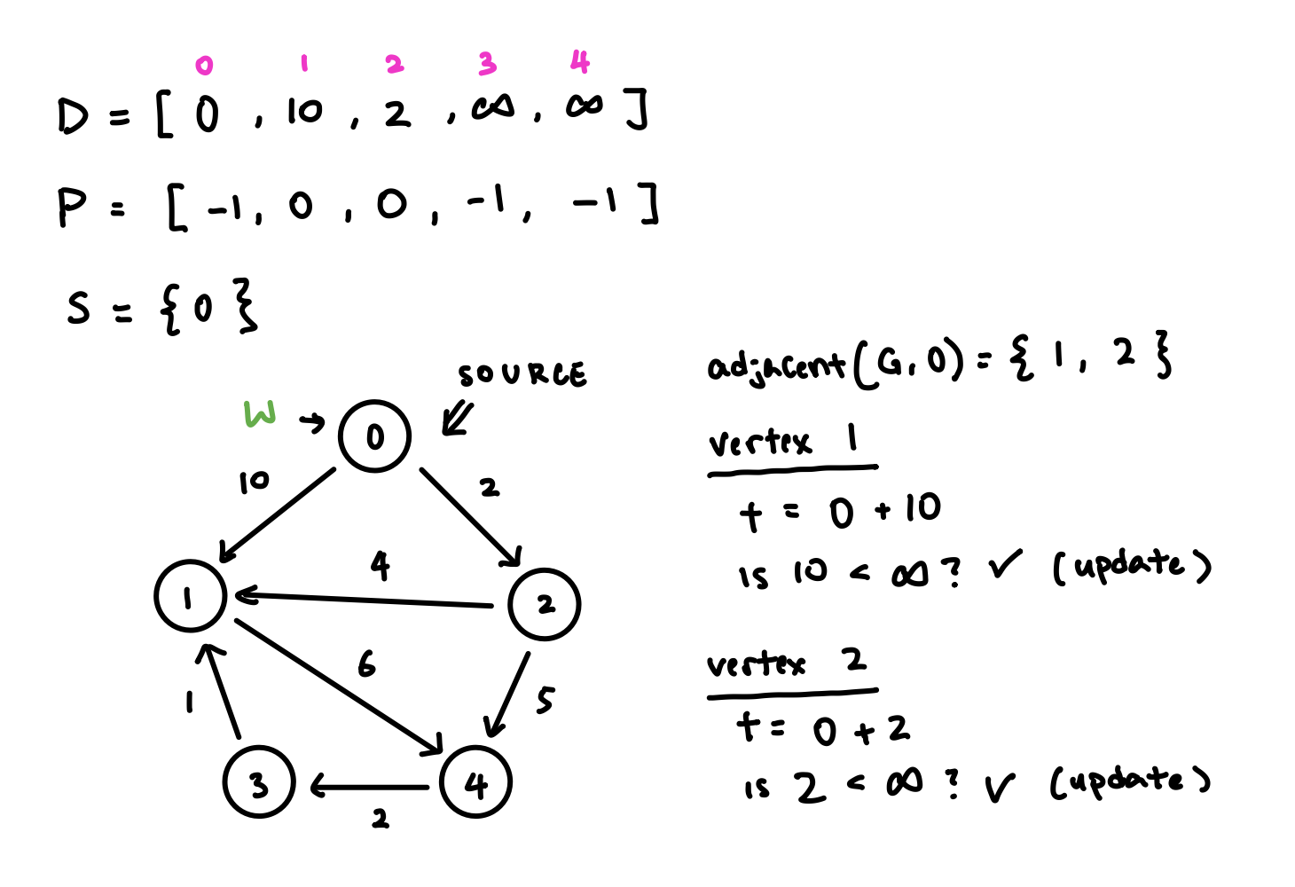
Dijkstra’s Algorithm

Slide 42
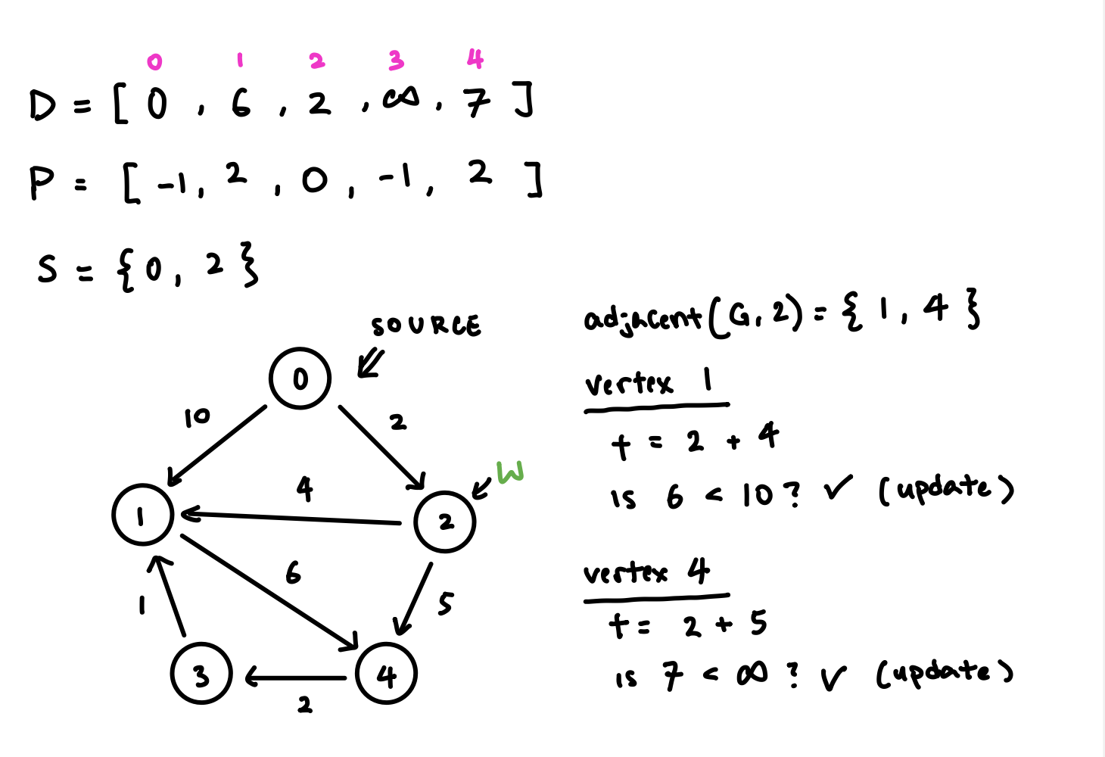
Dijkstra’s Algorithm

Slide 43
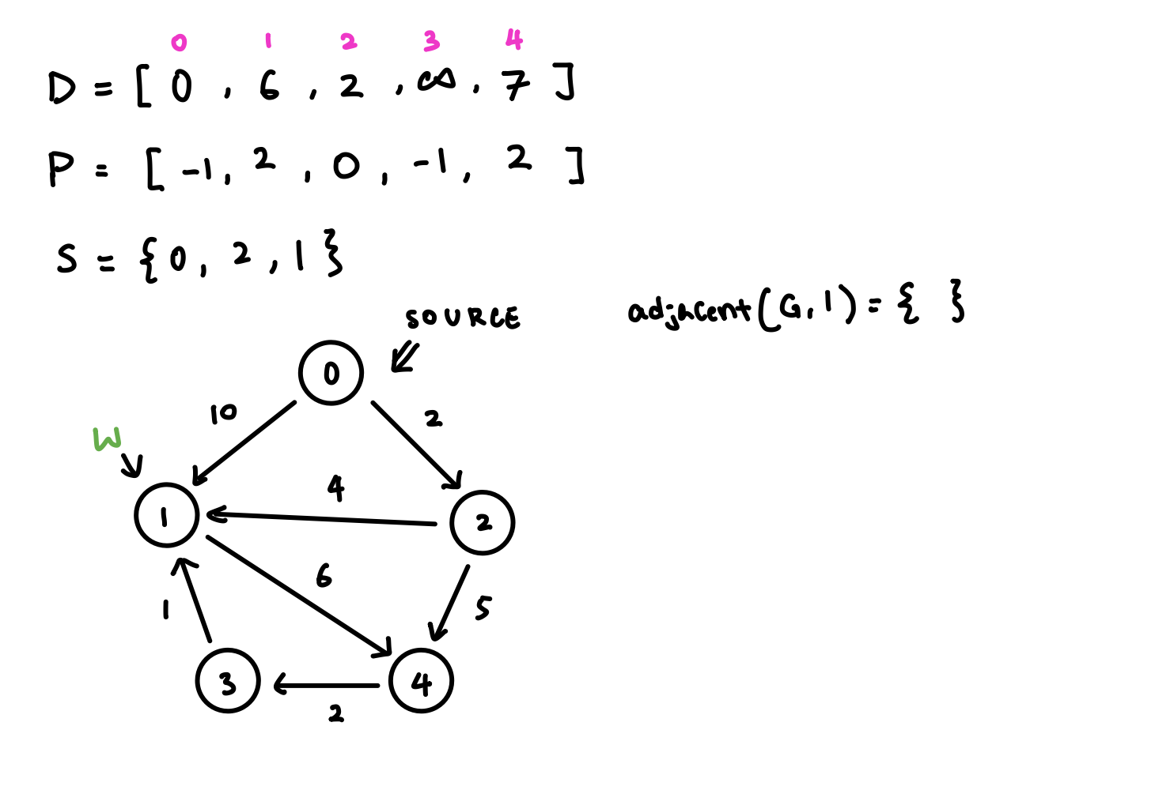
Dijkstra’s Algorithm

Slide 44
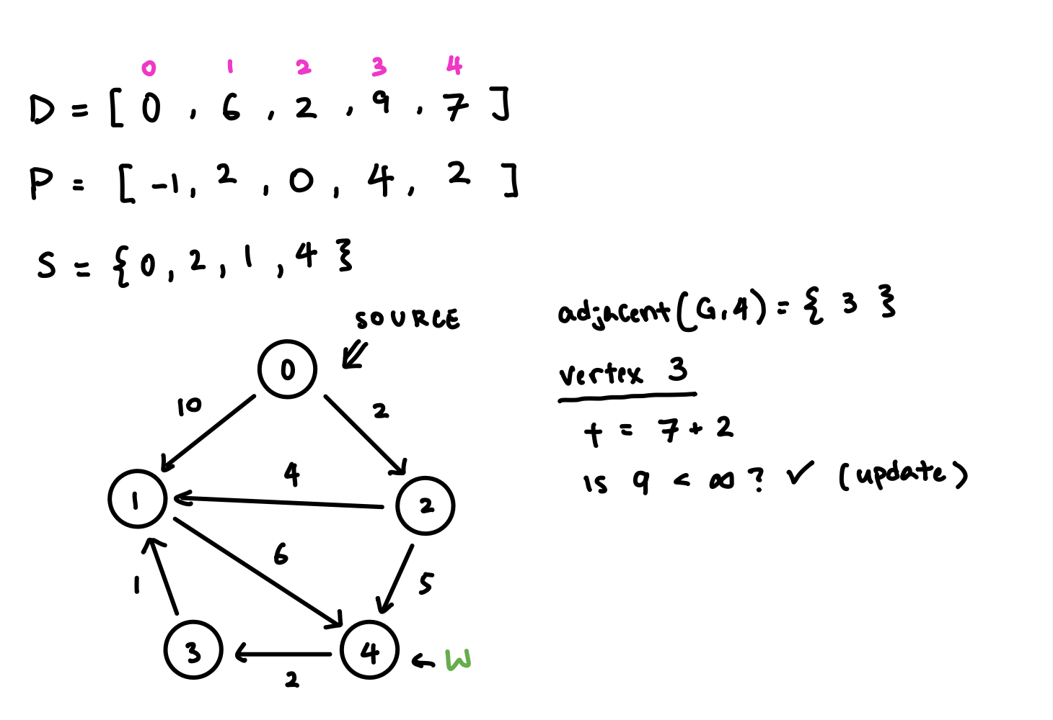
Dijkstra’s Algorithm

Slide 45
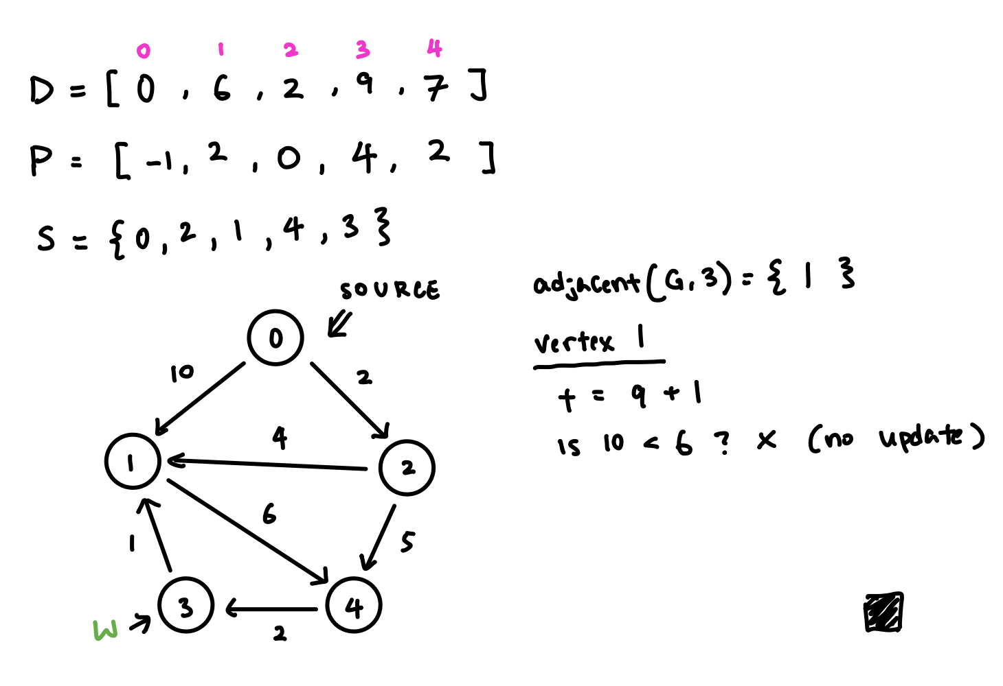
Dijkstra’s Algorithm

Slide 46
Hamiltonian Path
A path in an undirected or directed graph that visits each vertex exactly once.
Must start from an origin vertex and end up back at the origin.

Slide 47
Eulerian Path
A path in an undirected or directed graph that visits each edge exactly once.
Must start from an origin vertex and end up back at the origin.

Slide 48
Summary
Graphs pervade computer science.
Shortest path finding
Graph coloring
Network flow
Dependency ordering
… and so much more!
Come in undirected and directed forms.
Used generally to indicate relationships between entities.
Can be represented using either an adjacency matrix or using adjacency lists.

